Slide 1

Fire Prevention System
Group Number: G26
Group Members: 200566R, 200571D, 200582L

Slide 2
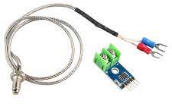
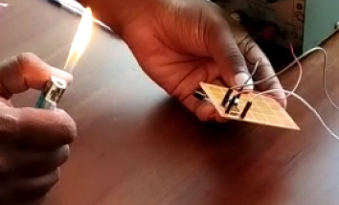
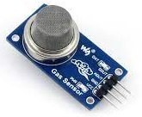
Sensors
IR Sensor
Temperature Sensor(MAX6675 Thermocouple Sensor)
Smoke Gas Sensor(MQ2 Smoke Gas Sensor)

Slide 3
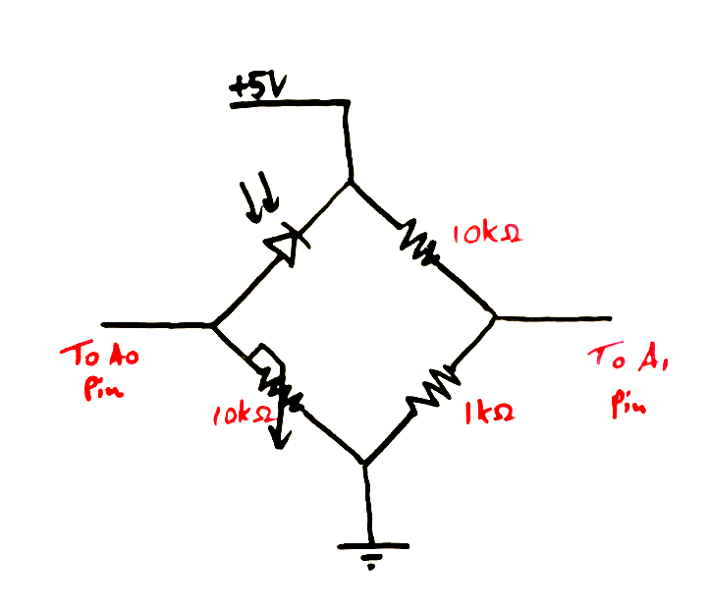
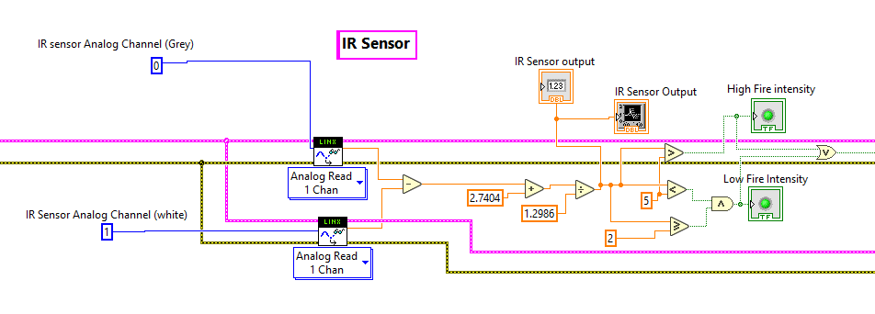
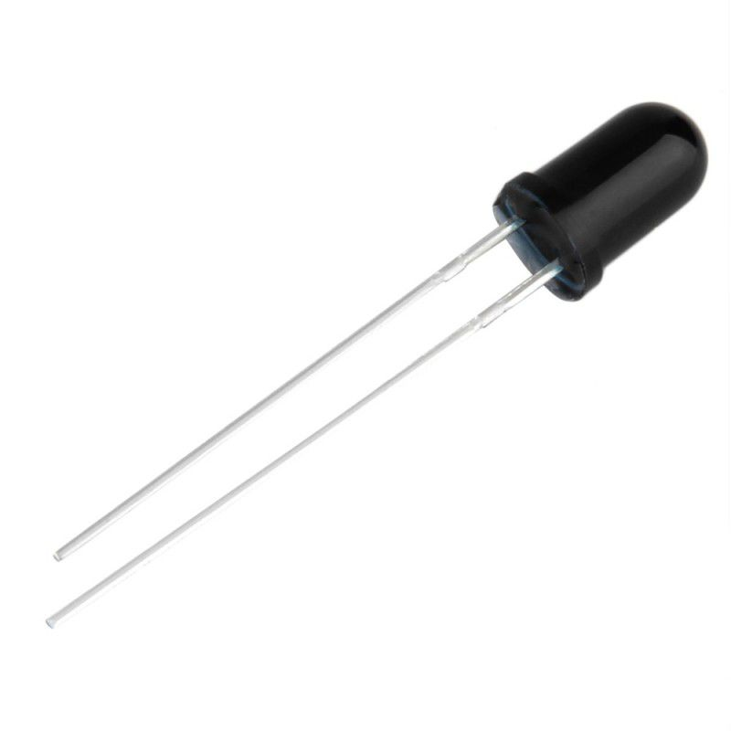
IR Sensor
Flame Height from Source(cm) | Voltage Reading (V)
2 | 0
2.5 | 0.41
3 | 1.05
3.5 | 1.32
4 | 2.67
5 | 4.02
5.5 | 4.3
6.5 | 4.31
7 | 4.33
8 | 4.34
9 | 4.36
Photo Diode

Slide 5
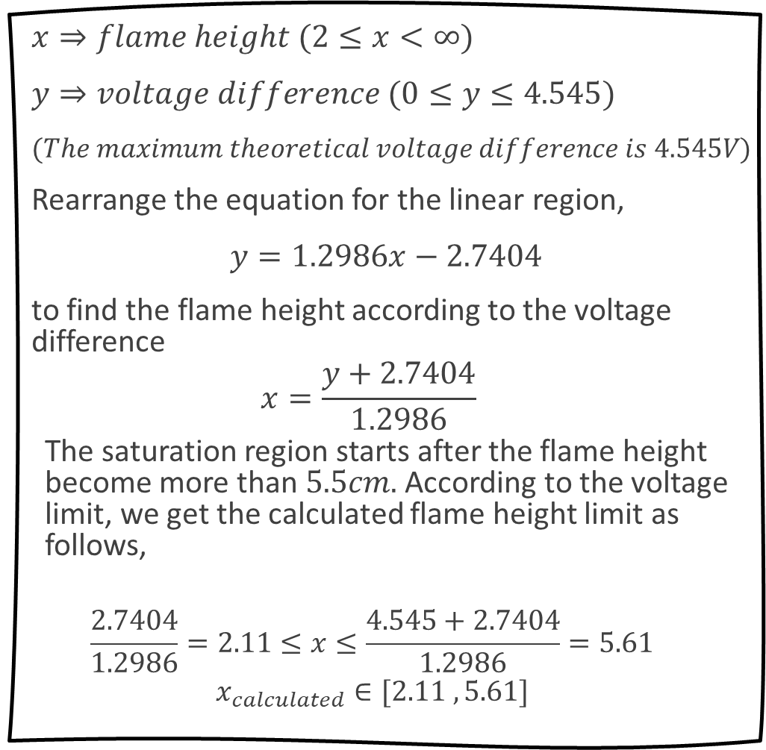

$x⇒flame height (2≤x<∞)$
$y⇒voltage difference (0≤y≤4.545)$
$(The maximum theoretical voltage difference is 4.545V)$
Rearrange the equation for the linear region,
$y=1.2986x−2.7404$
to find the flame height according to the voltage difference
$$x=\frac{y+2.7404}{1.2986}$$
The saturation region starts after the flame height become more than $5.5cm.$ According to the voltage limit, we get the calculated flame height limit as follows,
$$\frac{2.7404}{1.2986}=2.11≤x≤\frac{4.545+2.7404}{1.2986}=5.61$$
$$x_{calculated}∈[2.11 , 5.61]$$
When we calibrate the sensor, we took 2cm flame height as the 0V voltage difference point.
Wheatstone Bridge method
$${2cm≤x}_{calculated}<5cm⇒Low fire intensity$$
$$5cm≤x_{calculated} ⇒High fire intensity$$

Slide 6
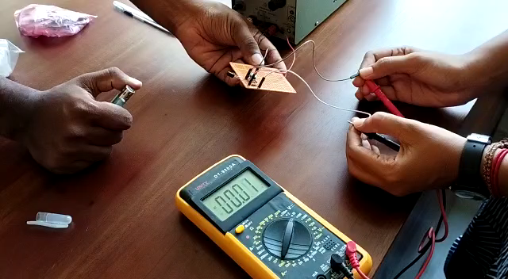
IR Sensor Calibration

Slide 7
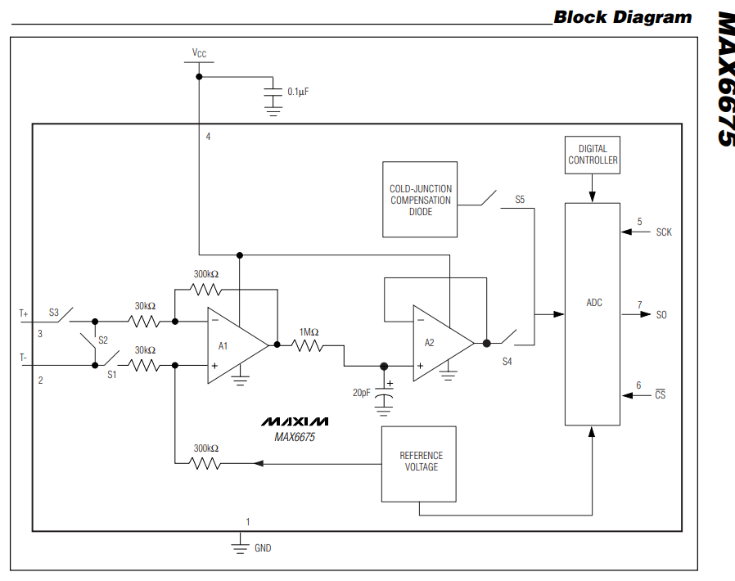
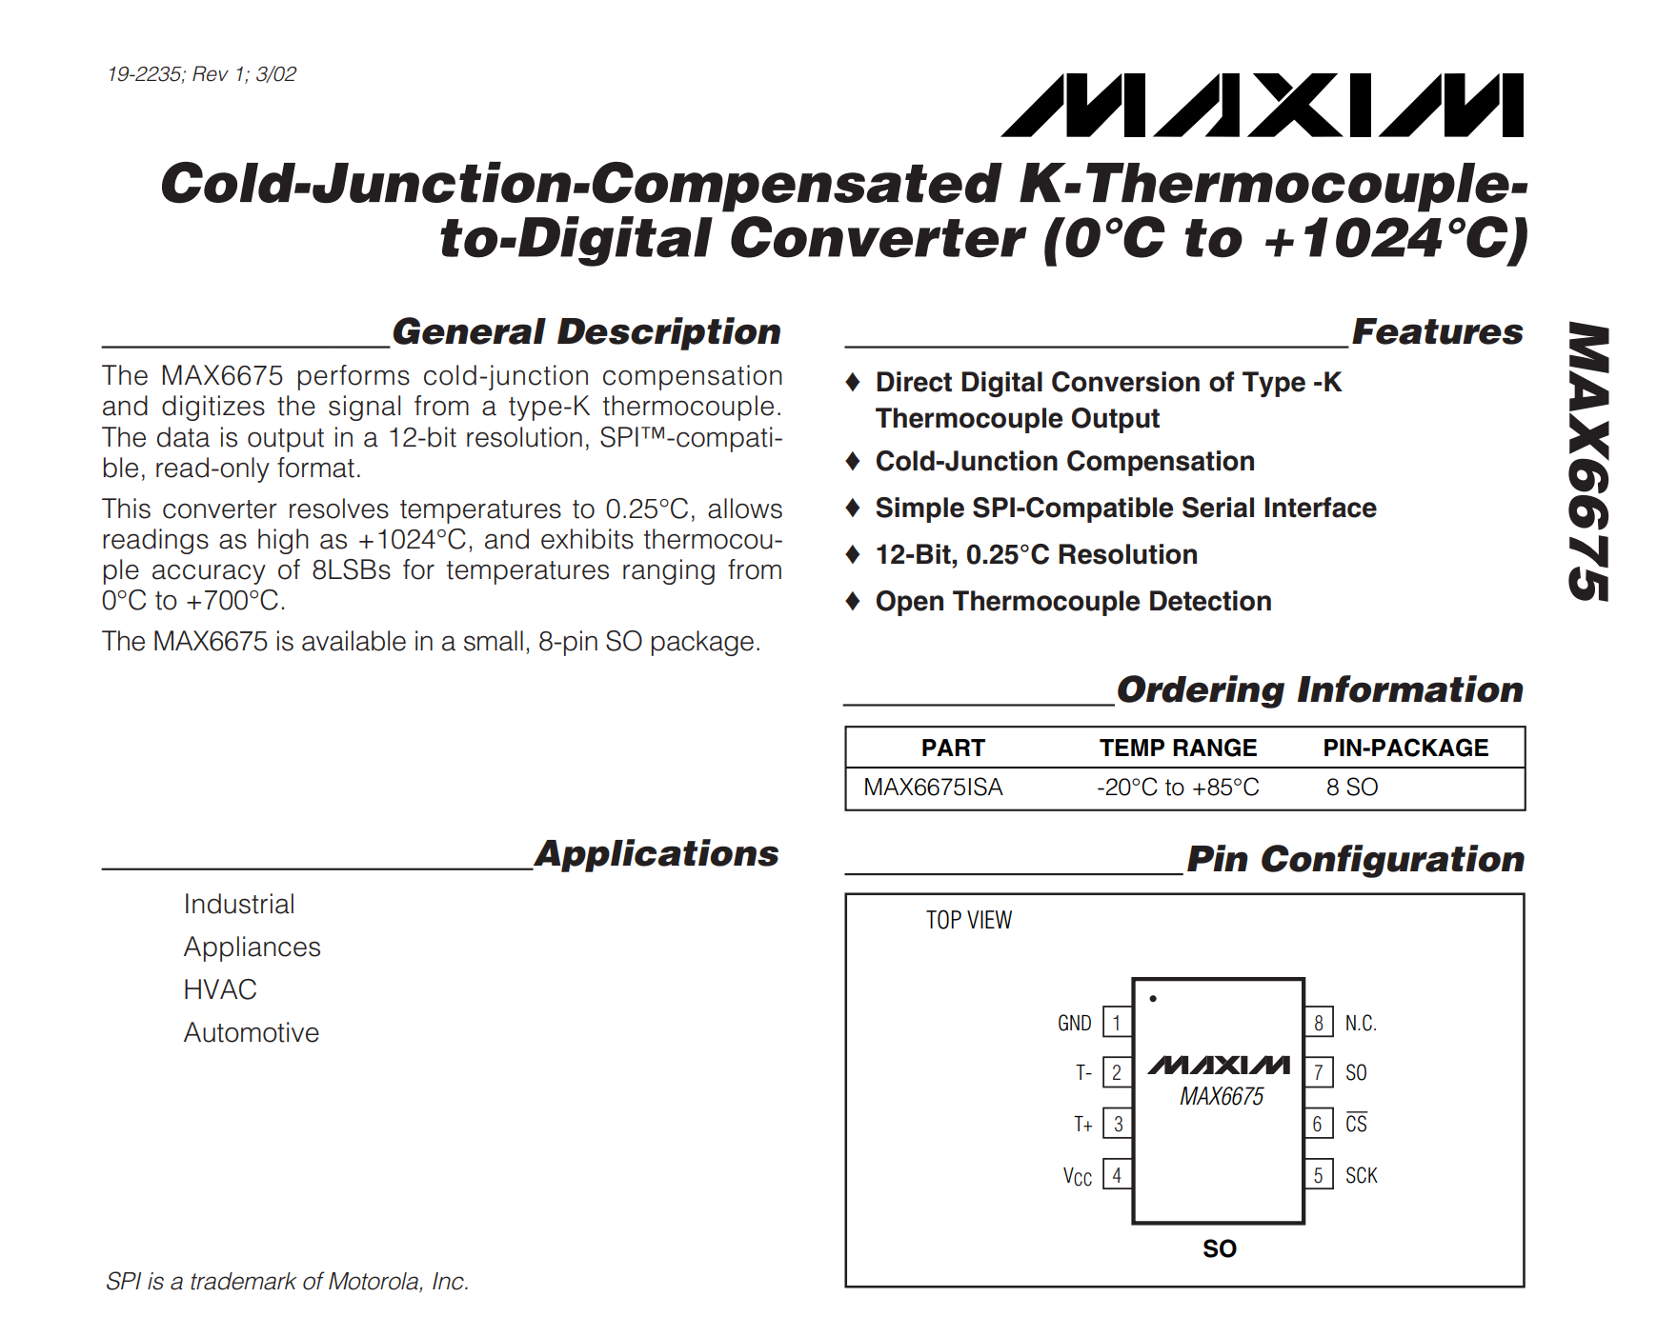

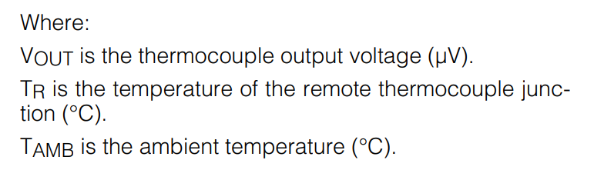
Temperature Sensor (MAX6675 Thermocouple Sensor)
Reference:- Data Sheet of MAX6675

Slide 8
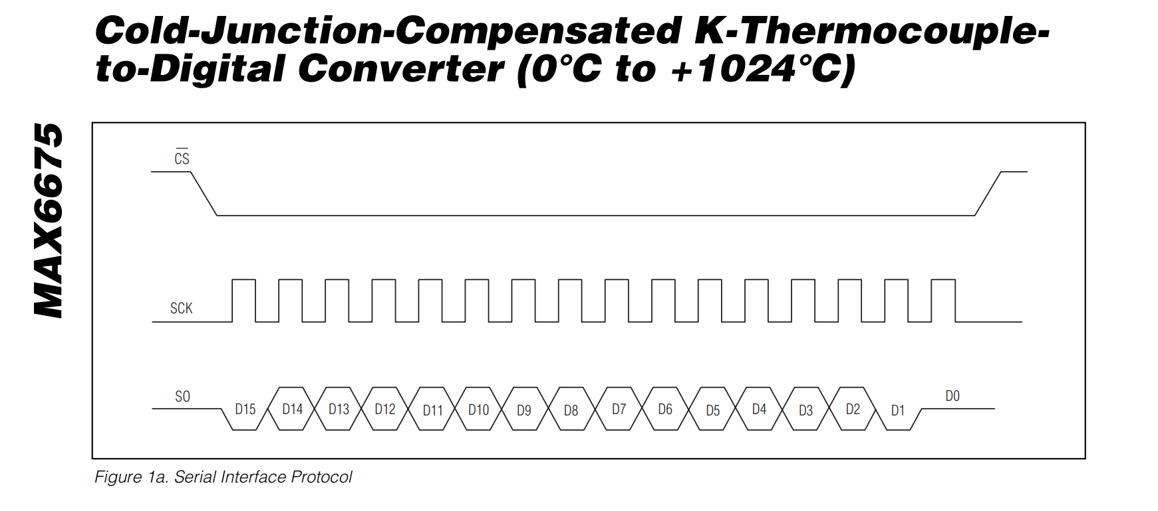
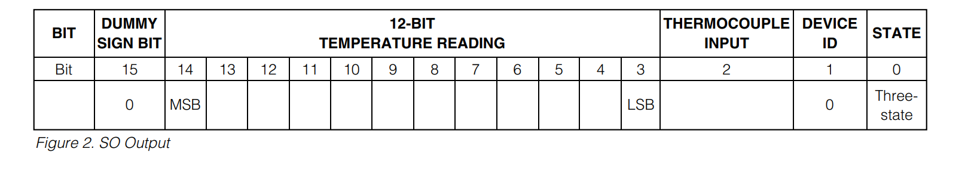
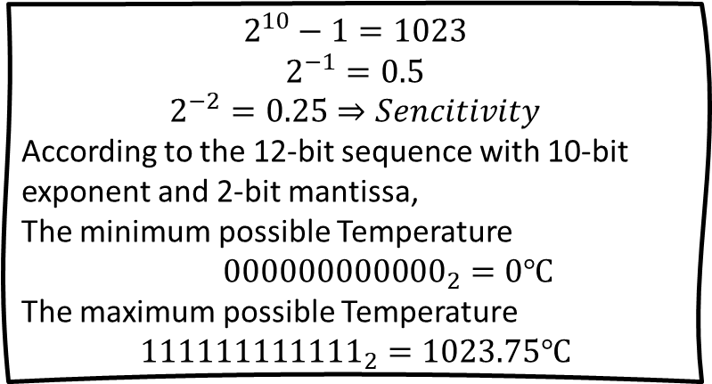

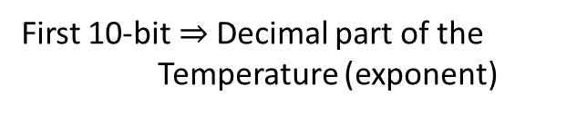
$$2^{10}−1=1023$$
$$2^{−1}=0.5$$
$$2^{−2}=0.25⇒Sencitivity$$
According to the 12-bit sequence with 10-bit exponent and 2-bit mantissa,
The minimum possible Temperature
${000000000000}_{2}=0℃$
The maximum possible Temperature
$${111111111111}_{2}=1023.75℃$$
12-bit sequence
First 10-bit$⇒$Decimal part of the Temperature (exponent)
Last 2-bit $⇒$ The Fractional part of the Temperature (mantissa)

Slide 9
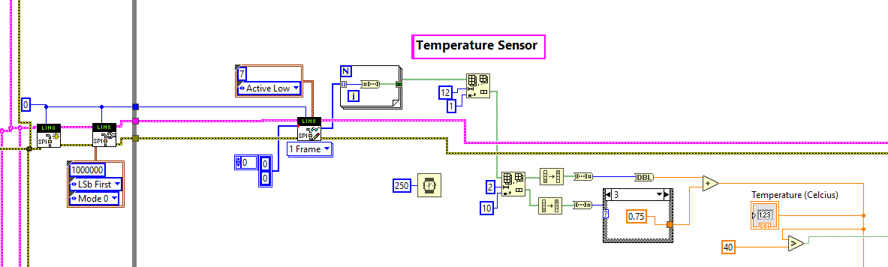
LabVIEW program for the Temperature sensor
SPI pins in Arduino uno: -
SS (Slave Select)/ CS (Chip Select) – 10
MOSI (Master Out Slave In) – 11
MISO (Master In Slave Out) – 12
SCK (Serial Clock) – 13

Slide 10
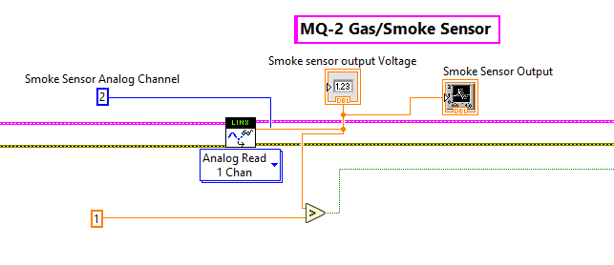
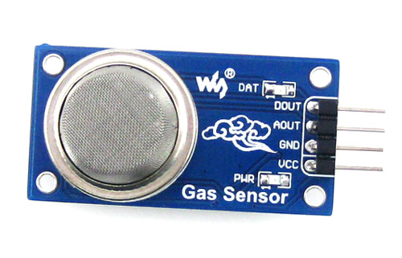
Smoke Gas Sensor (MQ2)
There are two types of outputs we can get.
We used analog output.

Slide 11
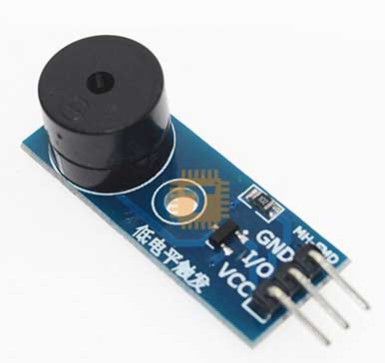
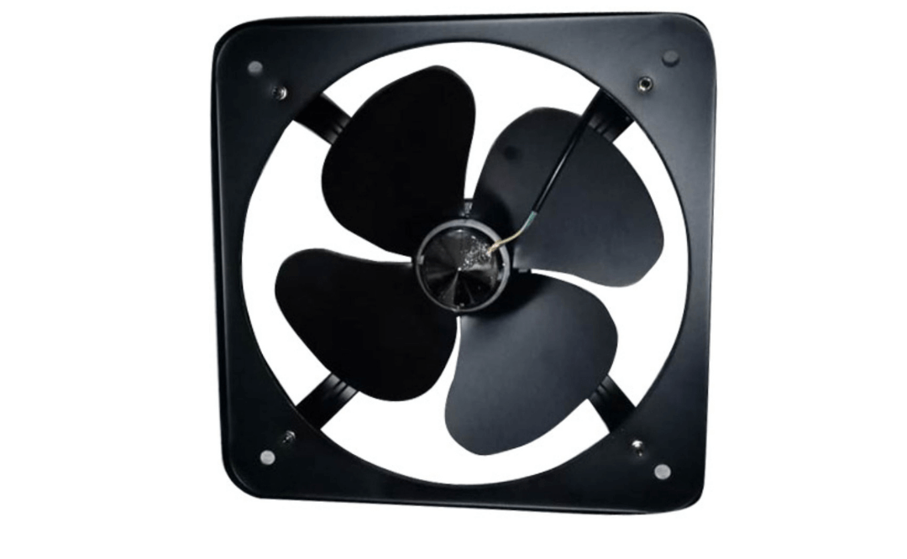
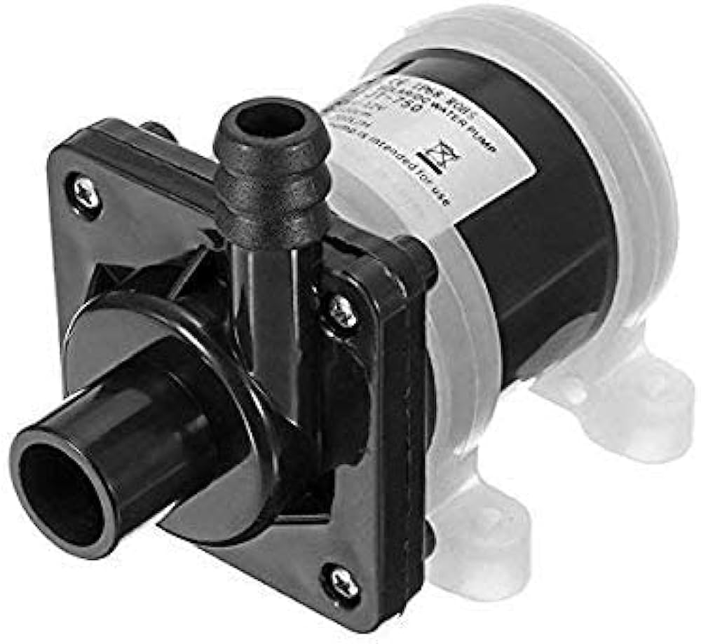
Actuators
Buzzer
Exhaust Fan
Solar Water Motor

Slide 12
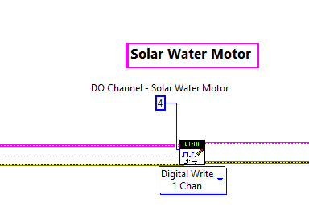
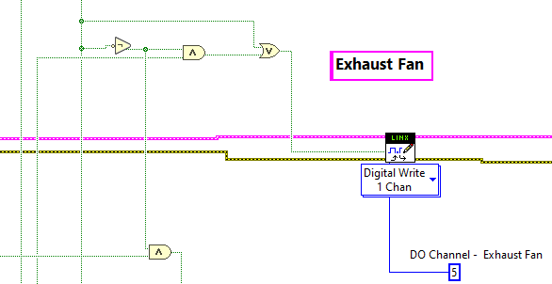
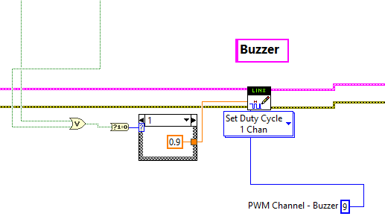
LabVIEW program for Actuators

Slide 13
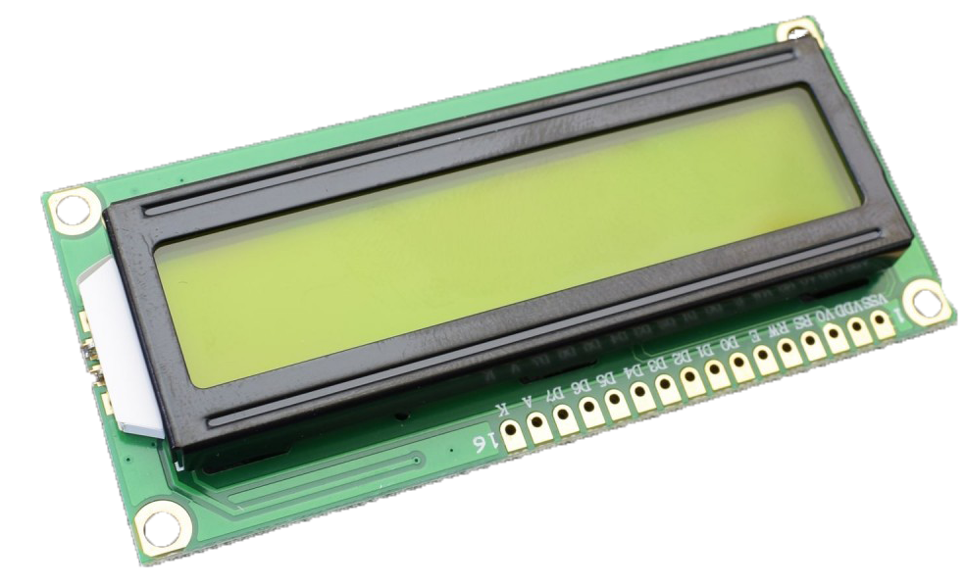
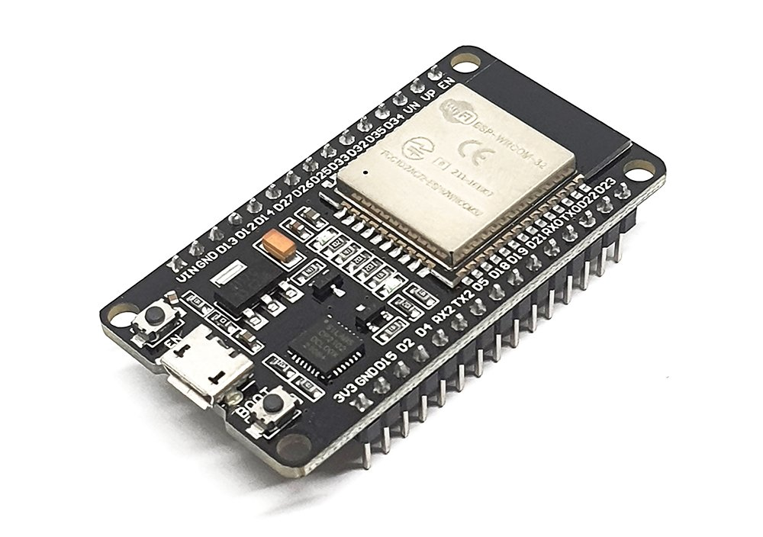
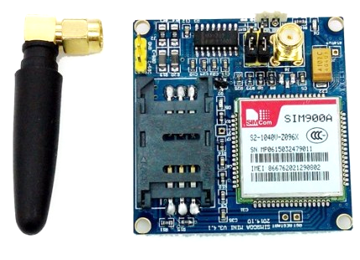
Peripheral Devices
LCD Display
ESP32 with GSM900A SMS Send

Slide 14
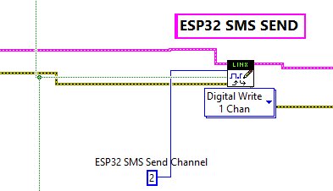
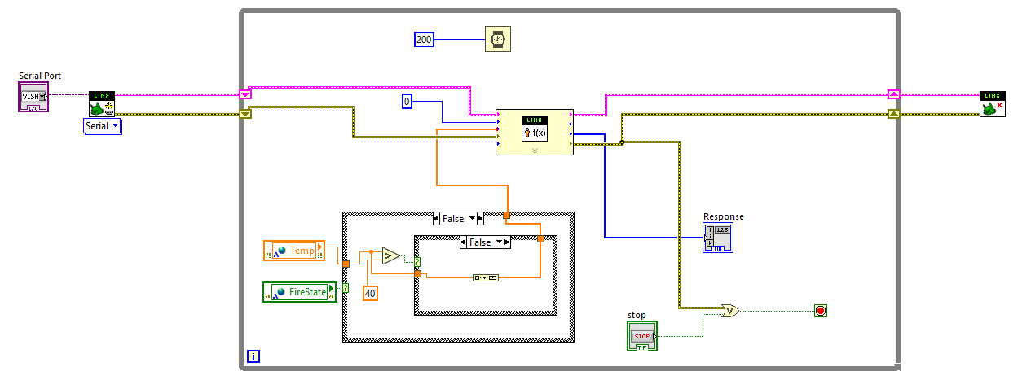
LabVIEW program for peripheral devices

Slide 15
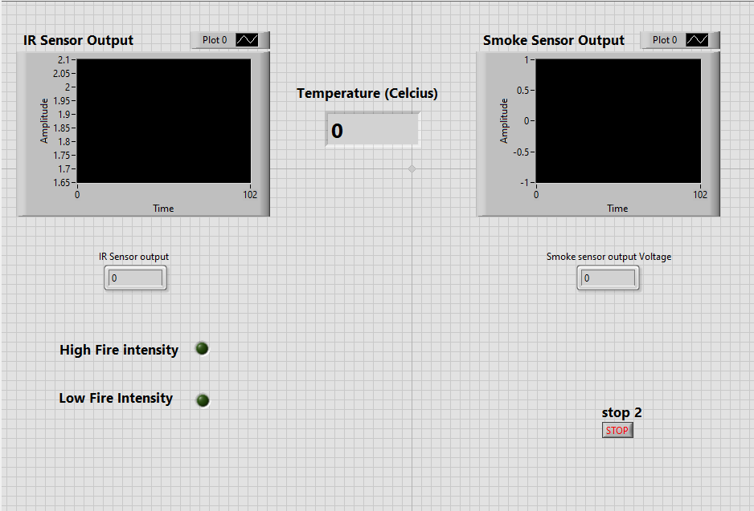
LabVIEW Interface

